Slide 1


Innovative aspects of the Companion Volume to the CEFR: an introduction
CEFR Companion Volume implementation toolbox
Implémentation du Volume complémentaire du CECR – Boîte d’outils
© 2023. This work is licensed under an Attribution-NonCommercial-ShareAlike International Creative Commons CC-BY-NC-SA 4.0 License. Fischer J. et al (2023), CEFR Companion Volume implementation toolbox, Council of Europe (European Centre for Modern Languages), Graz, available at www.ecml.at/companionvolumetoolbox.

Slide 2
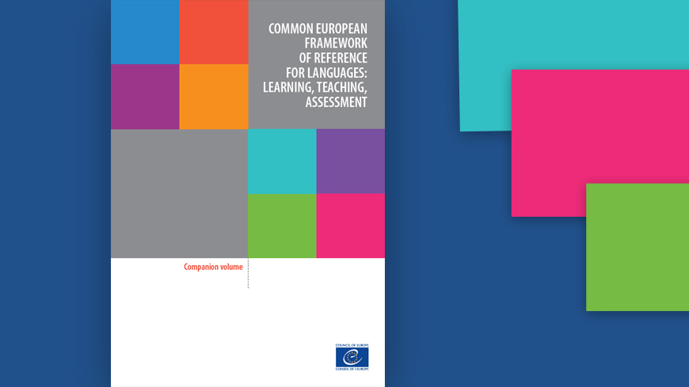
The Companion Volume is not a new CEFR. It introduces new scales and reformulations of some of the existing scales.

Slide 3
“New” aspects of the CEFR Companion Volume – relevant in the context of HEI and professional training
Overview:
revised scales and descriptors (pre-A1, C1, C2, plus levels)
action-oriented approach (learner as a social agent, collaborative tasks, co-construction of meaning)
four modes of communication (reception, production, interaction, mediation)
online interaction
mediation (20 scales)
plurilingual approaches
pluricultural aspects
… …

Slide 4
“New” aspects of the CEFR Companion Volume – relevant in the context of HEI and professional training
Overview:
… …
partial competences and individual skills profile
learner autonomy and self-reflected learning
diversity of approaches to assessment
→ paradigm shift

Slide 5
DeJong (2018)

Slide 6
If you want know more …
Council of Europe. 2001. Common European Framework of Reference for Languages: Learning, Teaching, Assessment. Council of Europe.
Council of Europe. 2018. Common European Framework of Reference for Languages: Learning, Teaching, Assessment. Companion Volume with New Descriptors. Council of Europe.
Council of Europe. 2020. Common European Framework of Reference for Languages: Learning, Teaching, Assessment. Companion volume. Council of Europe.
De Jong, J. 2018. Updates to the CEFR. In The CEFR Companion with New Descriptors: Uses and Implications for Language testing and Assessment. VIth EALTA CEFR SIG: 3-5.

